Slide 1

Single Sign-On with SAML

Slide 2








What is Single Sign-On?
Sign in to one application and gain access to all the other applications sharing the same session
Userstore
1
HR Application
2
Identity Provider (IdP)
WSO2 Identity Server
Accounts Application
Application User
[John Doe]
3
Sales Application

Slide 3
What is Security Assertion Markup Language (SAML)?
An XML-based markup language for security assertions
An open standard for exchanging authentication and authorization data between parties, in particular, between an identity provider and a service provider

Slide 4

SAML2 Participants
Who does what?
Subject/
Principal
Client Application/
Relying Party
Asserting Party
User
Service
Provider
Identity
Provider
[John Doe]
[Zoom]
[WSO2 Identity Server]

Slide 5

SAML2-Based Authentication
Message flow
1. Access
Service
Provider
[Zoom]
User
2. Authorization Request
[John Doe]
4. SAML Assertion
Authn statement
Attribute statement
3. Authenticate
Identity
Provider
[WSO2 Identity Server]

Slide 6
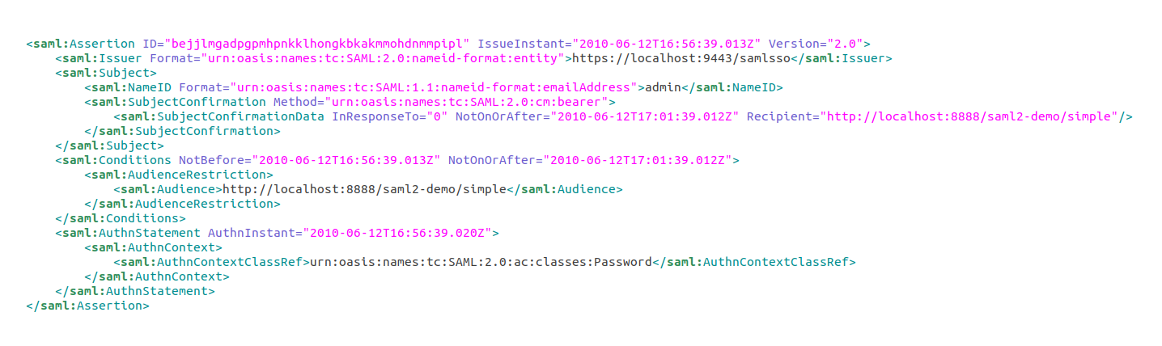
Sample SAML Assertion

Slide 7
SAML Specifications
SAML 2.0 Core
SAML 2.0 Bindings
SAML 2.0 Profiles
SAML 2.0 Metadata

Slide 8
Quick Recap

Slide 9

About Single Sign-On (SSO)
SAML2 participants
SAML2 authentication flow
SAML assertion
SAML specification
What you learnt

Slide 10



Any Questions ?
Reach us through the following channels
iam-dev@wso2.org
https://stackoverflow.com/questions/tagged/wso2-identity-server
https://discord.com/invite/Xa5VubmThw

Slide 11
Thank you!
Notes:
Acknowledge that it’s been a lot of changes within the team
Thank you for your taking onboard the feedback and being open to change.
A lot of work , a lot of learning, sometimes feeling twice the exhaustion
But also hopefully seeing what I see, which is: better ways of working, more innovation in our approach, more business acumen, more effective reactivity , more ahead of the game. Because that’s where marketing needs to be.
All this in a context where it’s also been a lot of changes for WSO2.
And from this standpoint I wanted to remind you of what Sanjiva said about you owning the culture

